Slide 1

SwiftVisa: AI-Based Visa Eligibility Screening Agent
Transforming visa applications through intelligent automation and conversational AI technology

Slide 2


The Visa Application Challenge Today
Every year, millions of Indian travellers, students, and professionals face a daunting maze of visa eligibility criteria across different countries. The complexity of immigration rules, varying documentation requirements, and ever-changing policies create significant barriers to international mobility.
Complex Criteria
Navigating multiple visa types with varying eligibility rules across countries
Traditional visa screening processes are labour-intensive, time-consuming, and vulnerable to human error. Applicants often struggle to understand which visa category suits their purpose, what documents they need, and whether they meet eligibility requirements before investing time and money in formal applications.
High Error Rates
Incomplete applications leading to delays, rejections, and financial losses
Manual Screening
Time-intensive processes prone to inconsistency and human oversight

Slide 3
Introducing SwiftVisa: Your AI Visa Eligibility Assistant
SwiftVisa is a revolutionary AI-powered conversational agent designed to transform the visa eligibility screening experience for Indian applicants. By leveraging advanced natural language processing and machine learning algorithms, SwiftVisa makes visa assessment accessible, accurate, and anxiety-free.
Conversational Intelligence
Instant Assessment
Smart Guidance
Provides real-time eligibility results based on comprehensive visa regulations
Delivers personalised document checklists and clear next steps for application success
Engages users in natural, intuitive dialogue to collect essential applicant information
SwiftVisa reduces errors, builds confidence, and empowers applicants to approach their visa journey with clarity and preparation before formal submission.

Slide 4
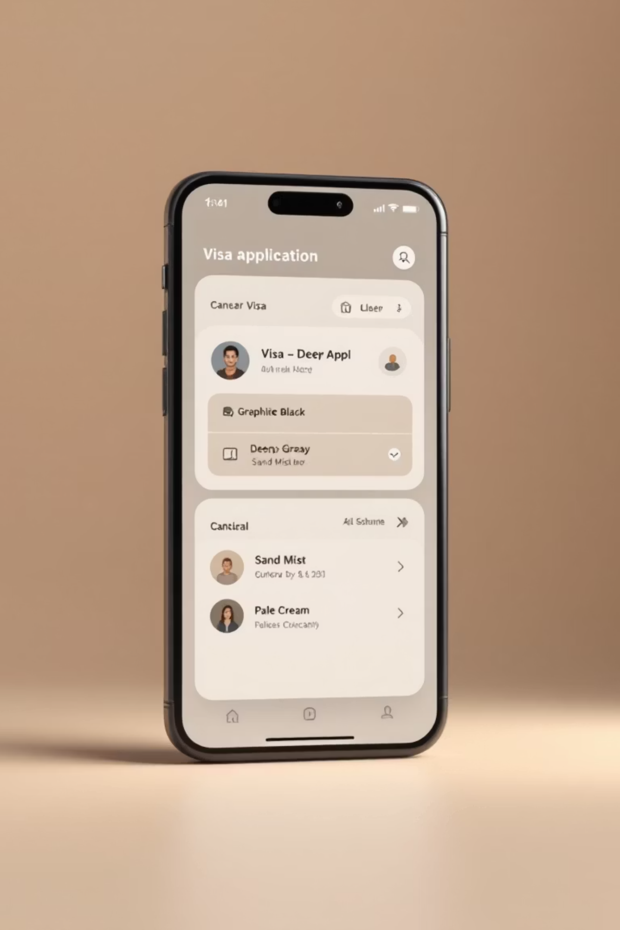




How SwiftVisa Works: Intelligent, Interactive, and User-Friendly
Natural Conversation
Users interact in everyday language, sharing travel purpose, destination, duration, and personal details through an intuitive chat interface
AI Analysis
Advanced algorithms trained on comprehensive visa policies analyse applicant data against eligibility criteria for multiple countries and visa categories
Tailored Results
Instant eligibility assessment with customised document checklists, requirements, and recommendations specific to the applicant's profile
Seamless Integration
Connects with official visa portals and application systems for smooth transition from screening to formal submission
The entire process transforms what traditionally takes days of research and consultation into a matter of minutes, whilst maintaining accuracy and comprehensiveness.

Slide 5
Real-World Impact: Efficiency and Accuracy Gains
SwiftVisa delivers measurable improvements across every stage of the visa application journey. By automating eligibility screening with AI precision, the platform significantly reduces the error rates that plague traditional manual processes.
40%
Applicants benefit from dramatically faster screening times, transparent eligibility criteria, and increased confidence in their application readiness. For visa service providers, travel agencies, and educational institutions across India, SwiftVisa means fewer incomplete applications, reduced processing backlogs, and improved client satisfaction.
Error Reduction
Fewer costly mistakes and rejections
95%
The platform's intelligent algorithms continuously learn from vast datasets of visa regulations, ensuring up-to-date guidance that reflects the latest policy changes from embassies and immigration authorities worldwide.
Time Saved
From days to minutes for screening
100%
Transparency
Clear eligibility criteria upfront

Slide 6
Case Study: Indian Student Visa Applications Simplified
In partnership with leading educational consultancies, SwiftVisa revolutionised the student visa application process for thousands of Indian students pursuing higher education in the United States and United Kingdom.
Challenge Identified
Results Achieved
High rates of incomplete applications and confusion around F-1 and Tier 4 visa requirements were delaying admissions
35% reduction in incomplete applications, faster turnaround times, and improved approval rates
1
2
3
4
SwiftVisa Deployed
Ongoing Success
AI agent integrated with consultancy workflows to screen thousands of student applicants
Personalised checklists aligned with embassy requirements now standard practice
Key Achievements
"SwiftVisa transformed our student counselling process. Our clients now approach visa applications with confidence and clarity, and our approval rates have never been higher."
Guided over 5,000 students through complex eligibility requirements
Reduced application preparation time by an average of 8 days
— Priya Sharma, Director, Global Education Consultancy
Provided country-specific document guidance for 15+ universities
Enabled consultants to handle 3x more applications with same resources

Slide 7

Security and Compliance at the Core
SwiftVisa is built on a foundation of robust security protocols and strict compliance with data protection regulations. We understand that visa applications involve highly sensitive personal information, including passport details, financial records, and biometric data.
1
Data Privacy Standards
2
Secure Infrastructure
Full compliance with Indian Personal Data Protection Bill, GDPR, and international privacy frameworks governing cross-border data transfers
End-to-end encryption, secure cloud storage, and multi-factor authentication protect all applicant information throughout the screening process
3
Regulatory Updates
4
Transparent Auditing
AI models continuously updated to reflect changing visa regulations, embassy requirements, and immigration policy shifts across all countries
Comprehensive audit trails ensure accountability, enable compliance verification, and build trust with users and regulatory authorities
Trust through Transparency: SwiftVisa maintains strict data governance policies and regularly undergoes independent security audits to ensure the highest standards of protection for applicant information.

Slide 8

The Future of Visa Screening with SwiftVisa
SwiftVisa's innovation roadmap extends far beyond current capabilities, with ambitious plans to become the world's most comprehensive AI-powered visa intelligence platform.
We're expanding coverage to include every major destination country and visa category, from tourist and business visas to work permits and permanent residency programmes. Advanced biometric verification and automated document authentication will further streamline the application process.
1
🌍 Global Expansion
Coverage extending to 180+ countries with support for specialist visa categories including investor visas, family reunification, and refugee applications
2
🔐 Advanced Verification
Integration of AI-powered biometric matching and intelligent document verification to detect inconsistencies and prevent fraud
3
🗣️ Multilingual Support
Conversational AI in 15+ Indian languages plus major international languages, ensuring accessibility for diverse applicant communities
4
🤝 Strategic Partnerships
Collaboration with government immigration departments, private visa service providers, and international organisations to standardise and modernise workflows

Slide 9






Why SwiftVisa Matters for India's Global Mobility
India is one of the world's largest sources of international travellers, students, and skilled professionals. Yet millions of Indians continue to struggle with complex visa processes that create barriers to global opportunities. SwiftVisa addresses this critical need through accessible AI technology.
Business Travel
Education Sector
Facilitating seamless mobility for entrepreneurs and corporate professionals
Supporting India's 1.3 million students studying abroad annually
Tourism Growth
Enabling India's expanding outbound tourism market
Tech Innovation
Positioning India as leader in immigration AI solutions
Administrative Relief
Reducing burden on visa offices and service providers
By democratising access to accurate visa information and screening, SwiftVisa empowers every Indian to pursue global opportunities with confidence, regardless of their background or resources.

Slide 10

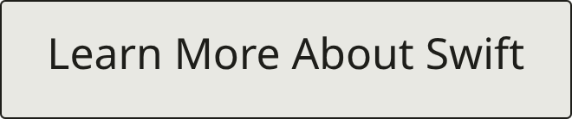
Join the SwiftVisa Revolution
Experience the future of visa eligibility screening today. SwiftVisa's AI-powered platform is ready to transform your visa journey with unmatched accuracy, lightning-fast processing, and crystal-clear guidance every step of the way.
1
⚡ Instant Screening
2
✓ Verified Accuracy
3
🎯 Personalised Guidance
Get your eligibility results in minutes, not days
AI trained on official visa regulations and policies
Customised checklists for your unique situation
Whether you're a student pursuing higher education abroad, a professional exploring career opportunities, or a traveller planning your next adventure, SwiftVisa provides the clarity and confidence you need to navigate the visa process successfully.
Unlock global opportunities with SwiftVisa — where AI meets immigration intelligence.

